Slide 1
WELCOME
TO
RICH ROSE
MARKETING
PVT. LTD.
Unveiling the Luxury of Nature

Slide 2
HOW
MANY
TIMES
WE GET
A LIFE ?

Slide 4
WELCOME TO LIFE CHANGING OPPORTUNITY

Slide 5
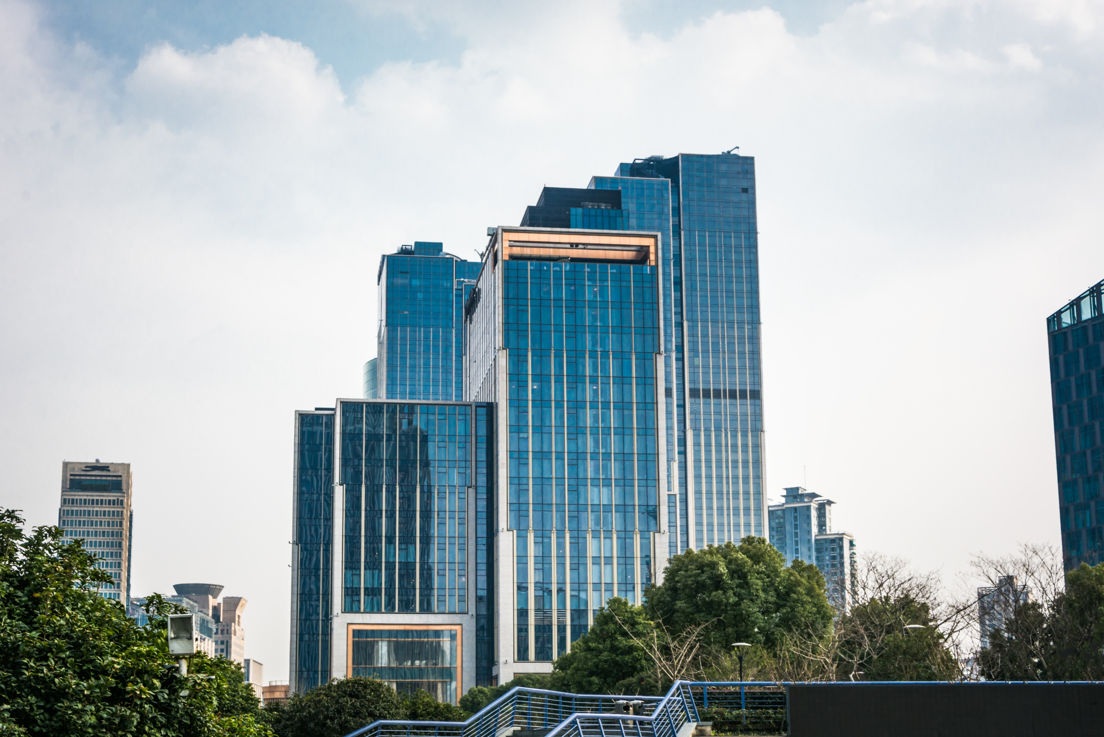
DIRECT SELLING COMPANY
EXPERIENCE OF MORE THAN
12 YEARS

Slide 6
Rich Rose
Enhancing Lives with Quality and Opportunity
Rich Rose Marketing, founded on a direct selling model, offers premium health and wellness products. Embracing the "Make in India" initiative, we aim to support and enrich lives, fostering financial freedom and independence. Our natural and organic products prioritize health and safety, committed to enhancing quality of life.
Incorporated in 2024, we are rapidly becoming a leading name in India's network marketing sector. Our success stems from building strong relationships with independent distributors, customers, and stakeholders. Our philosophy is to earn modestly from numerous satisfied clients, ensuring accessibility and affordability.
With a presence in over 15 states and 100 cities, and new stores opening daily, Rich Rose Marketing guarantees world-class service. Leveraging 12 Years of experience, we offer an ethical, hassle-free earning platform. Our product range includes health care, personal care, skin care, hair care, home care, and FMCG products. Headquartered in Ludhiana, Punjab, our mission is to deliver quality products at affordable prices, supporting distributor growth.
Headquartered in Ludhiana, Punjab, we offer quality products at affordable prices and comprehensive business support for distributor growth.

Slide 7
OUR MISSION
In today's economy, resources are vital, with time and human life being among the most valuable. Our goal is to empower individuals to transform their spare time into opportunities for substantial earnings through high-quality products and confident leadership.
OUR VISION
Our vision is to maintain high-quality standards and ensure our team performs efficiently and effectively in all business activities. We are committed to progress with responsibility, which is why we intend to comply with all regulatory and legislative requirements to achieve success in our future endeavors.

Slide 8
PRODUCTS

Slide 9
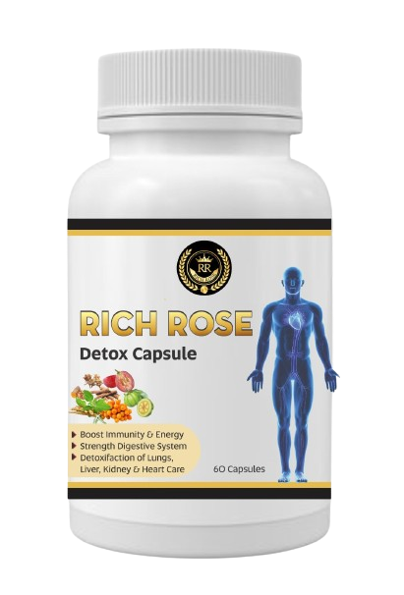
Rich Rose Detox Capsule

Slide 10
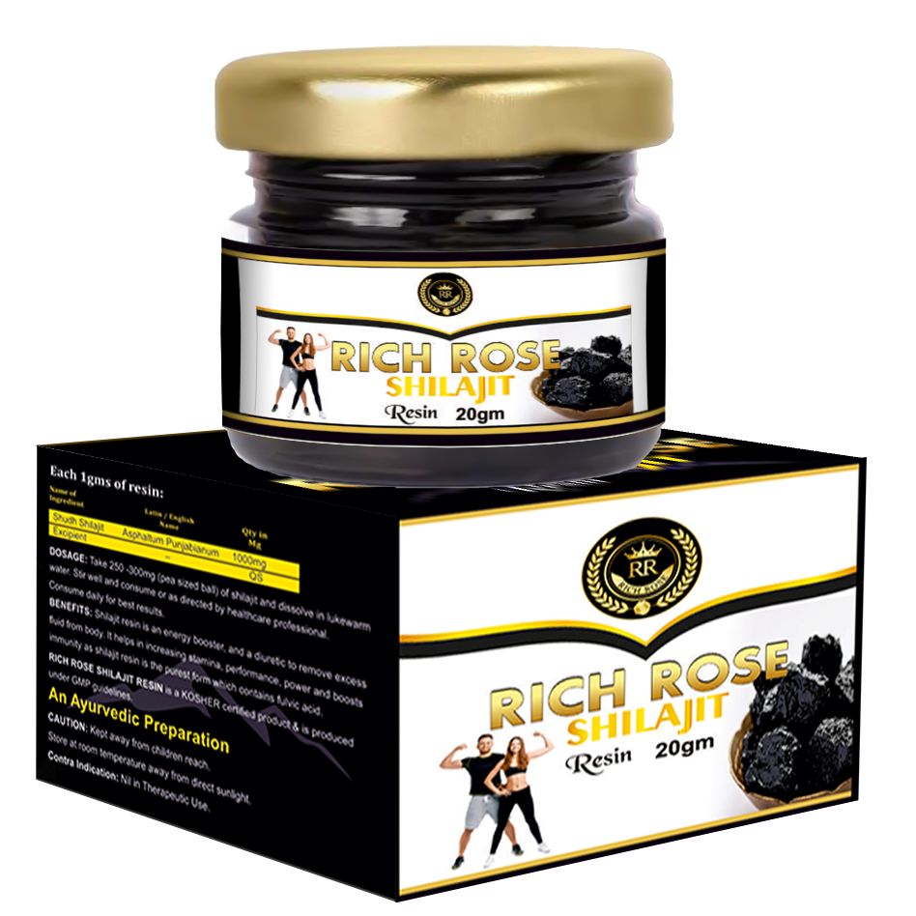
Rich Rose Shilajit Resin

Slide 11
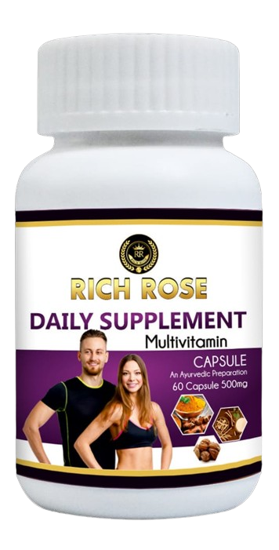
Rich Rose Daily Supplement

Slide 12
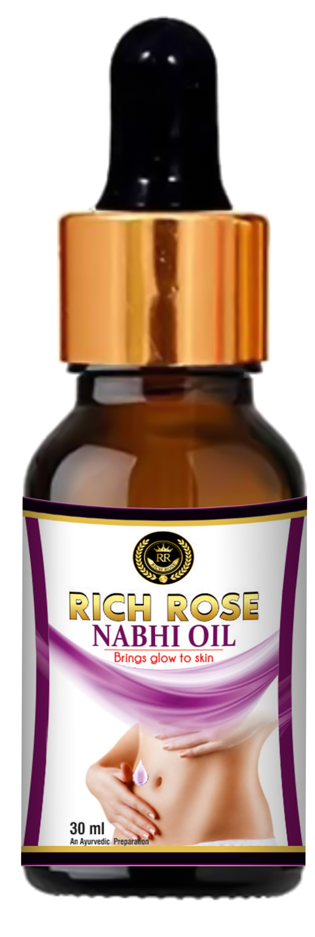
Rich Rose Nabhi Oil

Slide 13
Rich Rose Alakaline Drops

Slide 14
Rich Rose Anti Pain Oil

Slide 15
Rich Rose Dish Wash

Slide 16
TRADITIONAL SELLING V/S DIRECT SELLING
TRADITIONAL SELLING
DIRECT SELLING

Slide 17
BUSINESS PLAN
Free Registration.
For Activation retail only 100 BV
Product purchase (Multi order) in lifetime.
Get all Company benefits and start a lifetime in the company plan.
No reinvestment and the product refund policy is 15 days.
No Time Limits.
Pay-out: Weekly & last date of month

Slide 18
RETAIL PROFIT
25% to 30% For active Member.

Slide 19
Direct Sponsor INCOME
INCOME 250 INR on downline activation

Slide 20
PAIR INCOME
It will work in two Team Its Like A Team and B Team.
ON EACH 500BV match Get 1,000/-
TEAM / SALE
100,000 CAPING ON WEEK
A
B
500BV
500BV
CARRY FORWARD BOTH SIDE LIFE TIME.

Slide 21
LIFE TIME REWARDS
RANK | Group A BV | Group B BV | REWARD
Star | 1000 | 1000 | ₹1,000
Silver | 5000 | 5000 | ₹5,000
Gold | 20000 | 20000 | ₹25,000
Diamond | 75000 | 75000 | ₹2,50,000
Tycoon | 250000 | 250000 | ₹5,00,000
President | 600000 | 600000 | ₹10,00,000
Note: Life Time ,One time.

Slide 22
Gold CAR FUND
Qualified members will be awarded by 2% Monthly BV turnover divided equally .
GOLD for CAR FUND
2% BV CTO monthly turnover Equally in Gold
A
B
20000 BV to Qualify
20000 BV to Qualify
Life Time
Note: Income Criteria 1500 BV in each side Calendar Month
BV Monthly Turnover / Gold QUALIFIED MEMBERS

Slide 23
DIAMOND HOUSE FUND
Qualified members will be awarded by 2% Monthly BV turnover divided equally.
DIAMOND for HOUSE FUND
2% BV CTO monthly turnover Equally in DIAMOND
A
B
75000 BV to Qualify
75000 BV to Qualify
Life Time
Note: Income Criteria 3000 BV in each side Calendar Month
BV Monthly Turnover / DIAMOND QUALIFIED MEMBERS

Slide 24
TYCOON ELITE FUND
Qualified members will be awarded by 2% Monthly BV turnover divided equally.
TYCOON for ELITE FUND
2% BV monthly turnover Equally in TYCOON
A
B
250000 BV to Qualify
250000 BV to Qualify
Life Time
Note: Income Criteria 5000 BV in each side Calendar Month
BV Monthly Turnover / TYCOON QUALIFIED MEMBERS

Slide 25
PRESIDENT ROYALITY
TEAM BUSINESS MONTHLY REFRESH. BV BASED BOTH SIDE(LEFT & RIGHT).
Qualified members will be awarded by 2% Monthly BV turnover divided.
PRESIDENT for ROYALITY
2% CTO BV monthly turnover Equally in PRESIDENT
A
B
600000 BV to Qualify
600000 BV to Qualify
Life Time
2% BV Monthly Turnover / TYCOON QUALIFIED MEMBERS

Slide 26
OUR BANK
ACCOUNT NUMBER – 777705051656
BANK NAME – RICH ROSE MARKETING PVT.LTD.
IFSC CODE – ICIC0005638 BRANCH – DAD, LUDHIANA

Slide 27
THANK YOU

